Slide 1
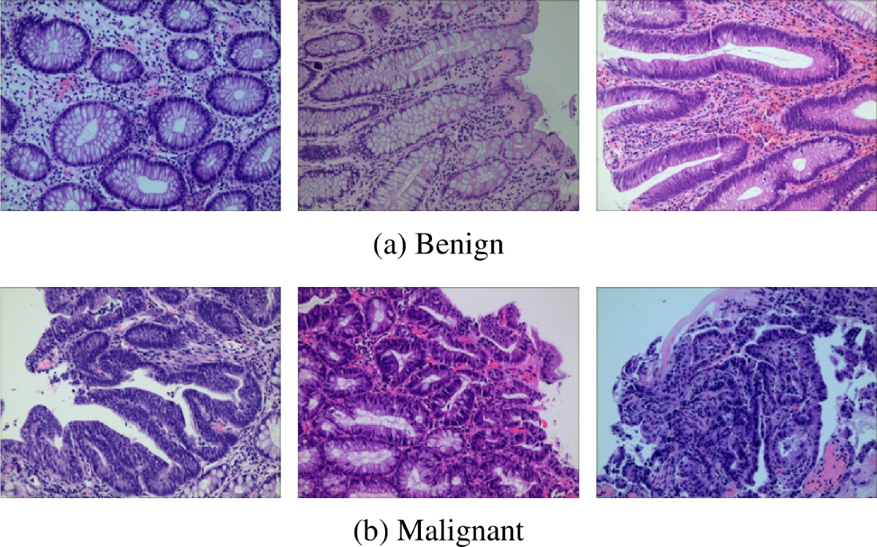





Explainable Vision Transformers for Histopathological Cancer Detection
Aya Gharsalli & Ferdaws Saidi
Under the supervision of Dr. Khemaies Abdallah
Deep Learning Course

Slide 2









Why Vision Transformers?
Clinical Challenge
CNN
ViT
• Cancer misdiagnosis — common medical error
Local receptive field first • Builds global view gradually • Misses long-range patterns
Global attention from start • All patches interact directly • Captures tissue relationships
• Pathologists are scarce & fatigued
• Early detection saves lives
Why ViT Over CNNs?
• Global context — sees whole image relationships
Colon — Binary Classification
• Higher accuracy on fine-grained datasets
Benign vs Adenocarcinoma
• Richer attention maps for XAI
Lung — 3-Class Classification
Benign vs Adenocarcinoma vs Squamous Cell Carcinoma

Slide 3



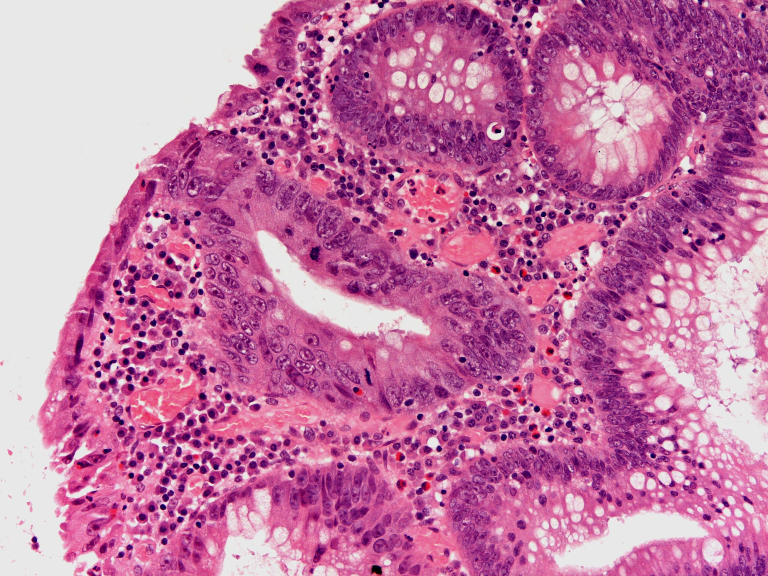



LC25000 Dataset & Histopathology Fundamentals
LC25000 Dataset
25K
5K
768²
Total Images
Per Class
Resolution
H&E Staining
Hematoxylin → Nuclei (Blue/Purple)
Eosin → Cytoplasm (Pink)
Benign Tissue
Malignant Tissue
Cancer Indicators
Irregular nuclei • Abnormal cell shapes • Atypical tissue architecture
Colon
Lung
colon_aca • colon_n
lung_aca • lung_scc • lung_n

Slide 4

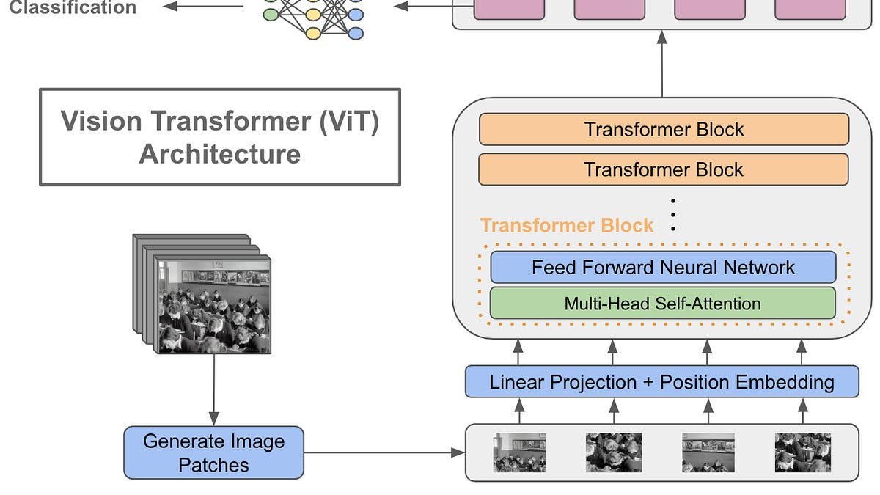


ViT-B/16: From Patches to Predictions
1
Patch Splitting
224×224 → 196 patches of 16×16
2
Patch Embedding
768 raw values → 768-dim vector per patch
3
CLS Token + Positional Encoding
Prepended token + learnable position embeddings
4
12 Transformer Blocks
MHSA (12 heads) + FFN (768→3072→768) + Residual
5
Classification Head
Transfer Learning
Model Size
Linear(768→2) Colon | Linear(768→3) Lung
Pre-trained on ImageNet-21k
86M
14M images • 21k categories
Parameters

Slide 5




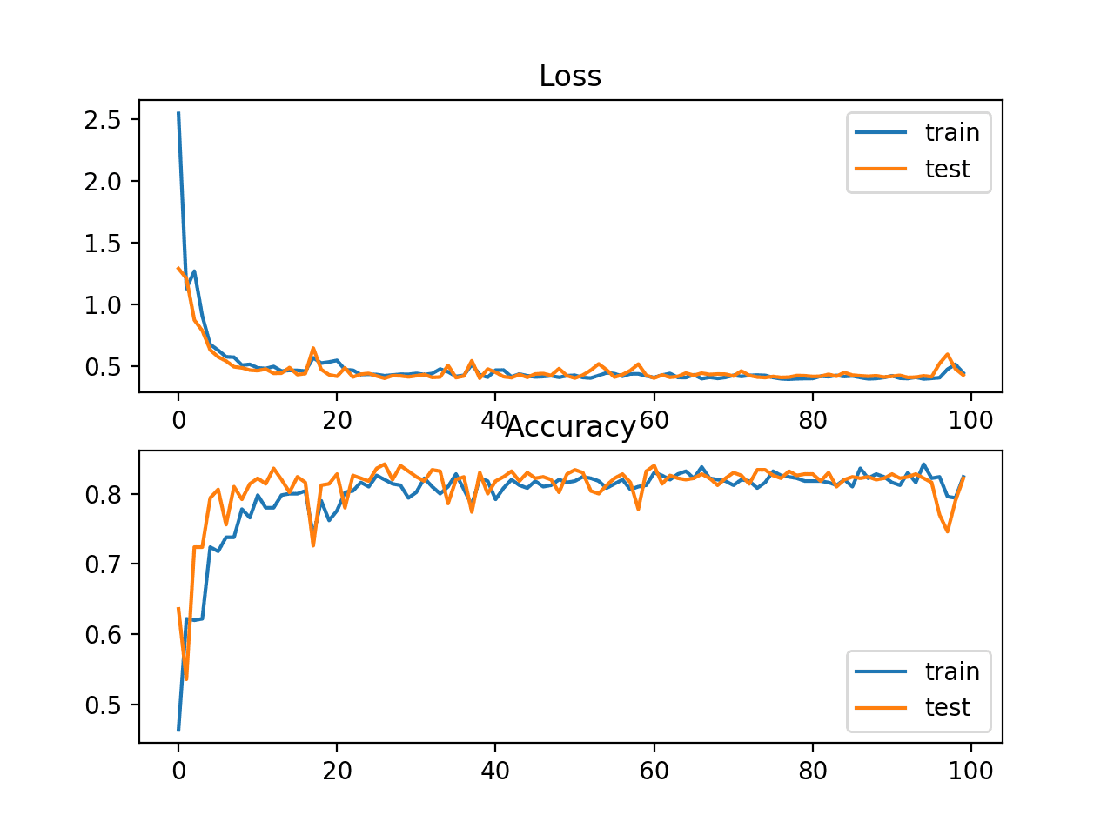


Optimization Pipeline for Medical Imaging
Data Augmentation
AdamW (Not Adam)
Horizontal/Vertical Flip
Random Rotation (±15°)
Decoupled weight decay • Proper L2 regularization • Better generalization for Transformers
No canonical orientation
Slide placement variation
ColorJitter
Compensates for stain variation between labs
Cosine Annealing (Not Step Decay)
Smooth decay 2e-4 → 1e-6 • No abrupt drops • Better convergence
Mixed Precision (FP16)
2× faster training • 50% less VRAM • Same accuracy
Class-Weighted Loss (Lung)
Penalizes errors on harder classes • Compensates for imbalance
Cosine Annealing: Smooth LR Decay

Slide 6


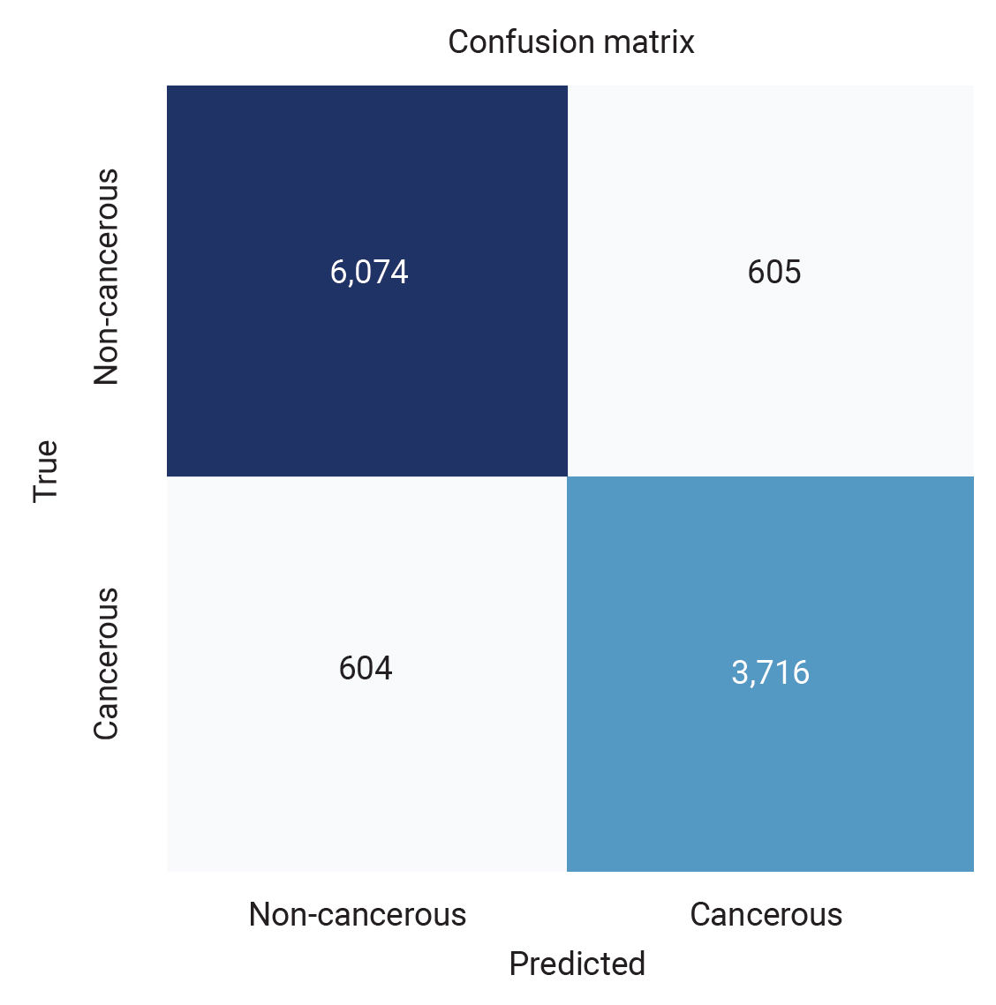
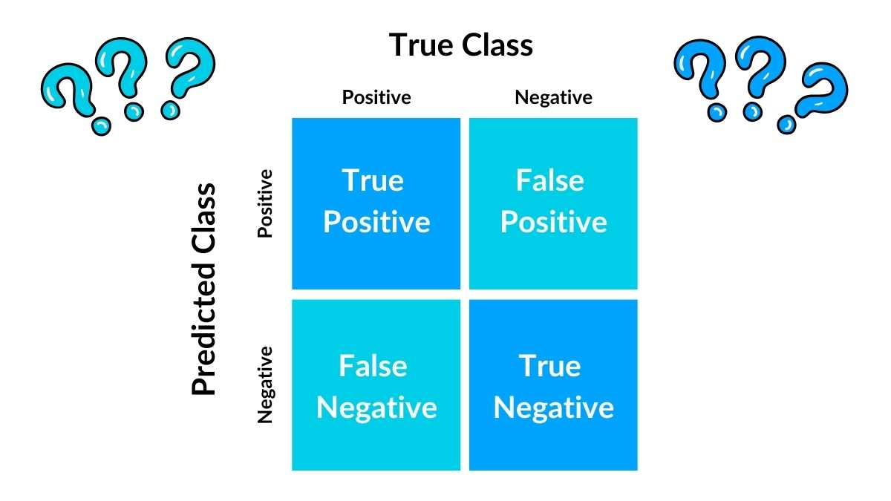



Clinical-Grade Performance
Colon Confusion Matrix
Lung Confusion Matrix
Colon Classification
Test Accuracy
Macro F1
99.93%
0.9993
Lung Classification
Test Accuracy
Macro F1
99.82%
0.9982
Clinical Priority
Benign
Adenocarcinoma
Squamous Cell
Recall > Precision
F1 ≈ 0.999
F1 ≈ 0.999
F1 ≈ 0.999
Missing cancer (FN) is worse than false alarm (FP)
Averages F1 across all classes equally • Most informative for 3-class problems

Slide 7



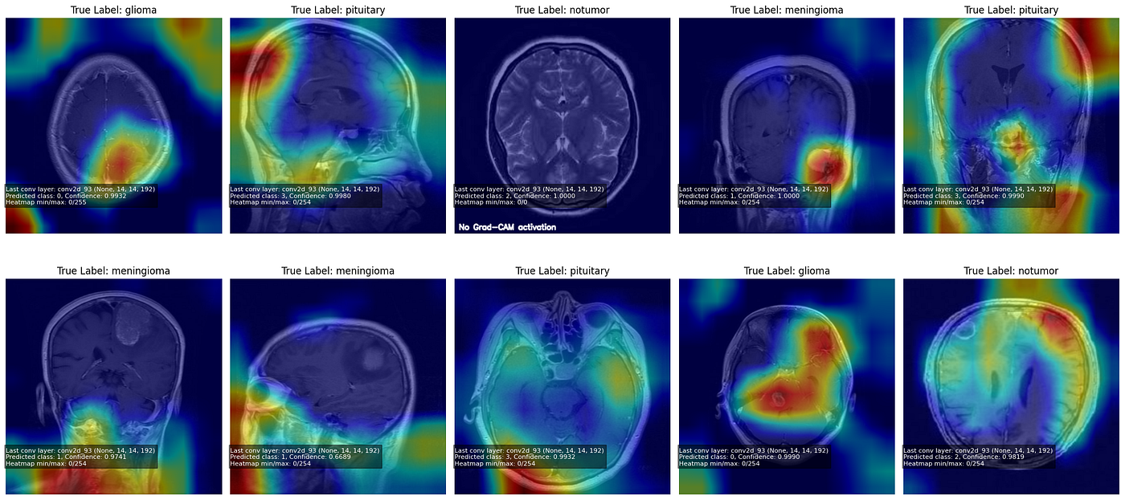
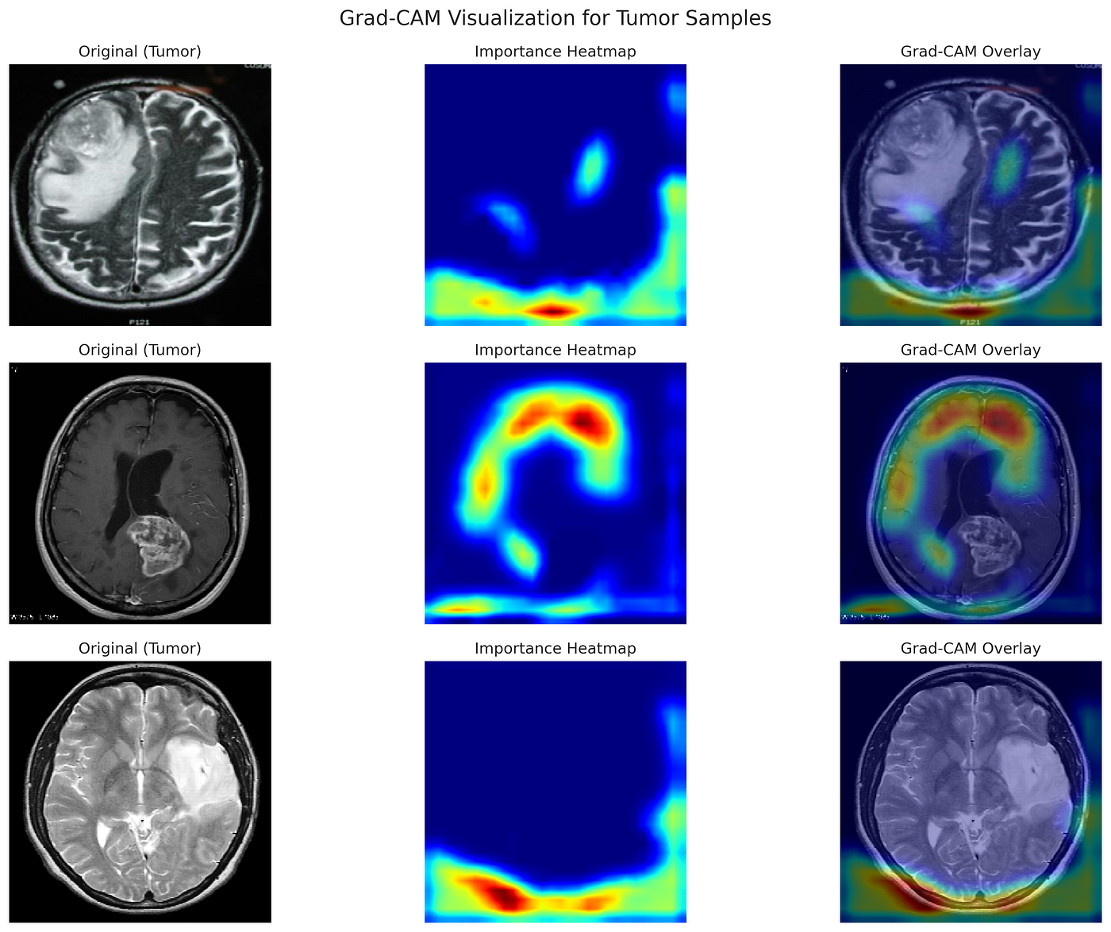



Transparent AI: From Black Box to Clinical Insight
Attention Rollout
Class-Agnostic
• Propagates attention through 12 layers
• Shows global attention flow: WHERE model looks overall
• Head fusion + discard ratio for noise reduction
Grad-CAM for ViT
Class-Discriminative
• Gradient-weighted activations from last block
• Shows prediction-specific: WHAT drives each prediction
• ReLU keeps only positive contributions
Original Image
Attention Rollout
Grad-CAM
Key Difference
Raw tissue sample
Global attention flow
Class-specific regions
Rollout
Grad-CAM
Clinical Value
Same map regardless of class
Different maps per class
Heatmaps reveal model focuses on histological structures (not artifacts) • Enables pathologist verification • Builds trust

Slide 8




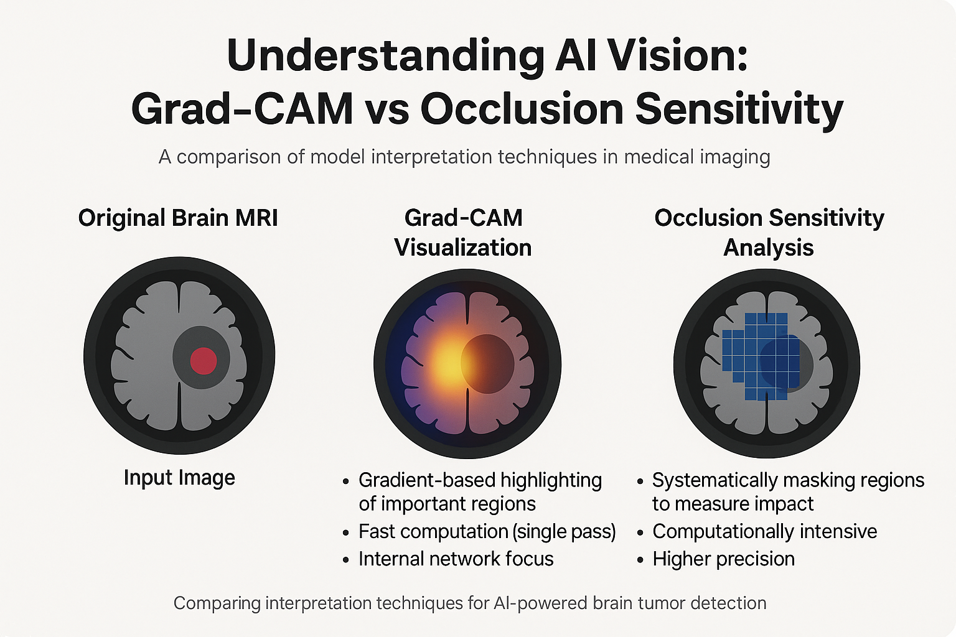






Bridging Deep Learning and Clinical Practice
Key Contributions
Future: Multi-Modal Fusion Architecture
• 99.93% Colon / 99.82% Lung
Histopathology
Radiology
Clinical Data
• Novel XAI for ViT in histopathology
ViT-B/16
ViT-S/16
MLP Encoder
• Dual explanation builds clinical trust
768-dim
384-dim
128-dim
Clinical Impact
Fusion: 768 + 384 + 128 = 1280 dim → MLP → Classification
Clinical metadata: age, smoking history, stage, biomarkers, lymph node involvement
• Enables pathologist verification
• Reduces diagnostic errors & variability
• AI as second opinion, not replacement
Lung: 3 classes
Colon: 2 classes
Multi-Organ Extension
Breast: 2 classes
• Organ-agnostic pipeline design
Easy extension...
• Auto-generate custom heads
• Consistent XAI across organs
ViT (Ours)
CNN Baselines

Slide 9




Thank You
Questions & Discussion
PREPARED BY
AYA GHARSALLI & FERDWAS SAIDI
Supervisor
Course
Dr. Khemaies Abdallah
Deep Learning

